Slide 1

Norm Group Characteristics
Oli Clark

Slide 2
This Video
Sampling Distributions
Sample characteristics
Standard scores
Deviations

Slide 3
Describing Groups
Latent Variable Modelling
Classical Test Theory
Sum Score
Mean Score
Strongly Disagree | Slightly Disagree | Neither Agree nor Disagree | Slightly Agree | Strongly Agree

Slide 4
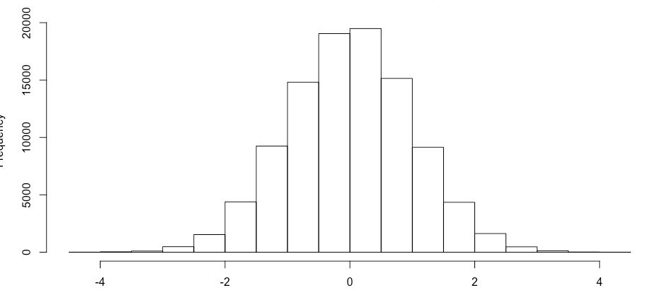
Sampling Distributions

Slide 5
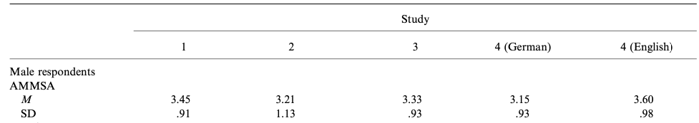
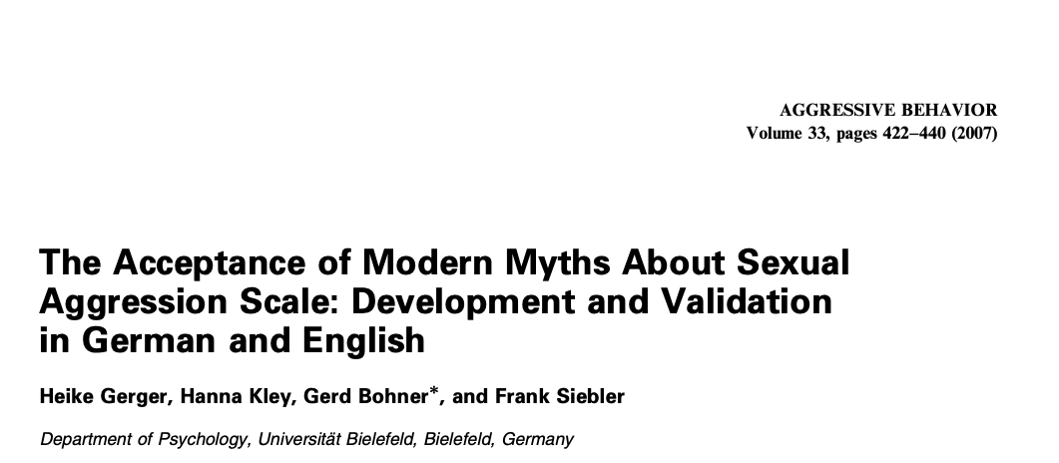
Sampling Distributions

Slide 6
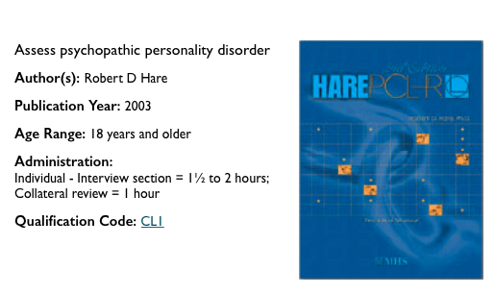
Norm Groups

Slide 7
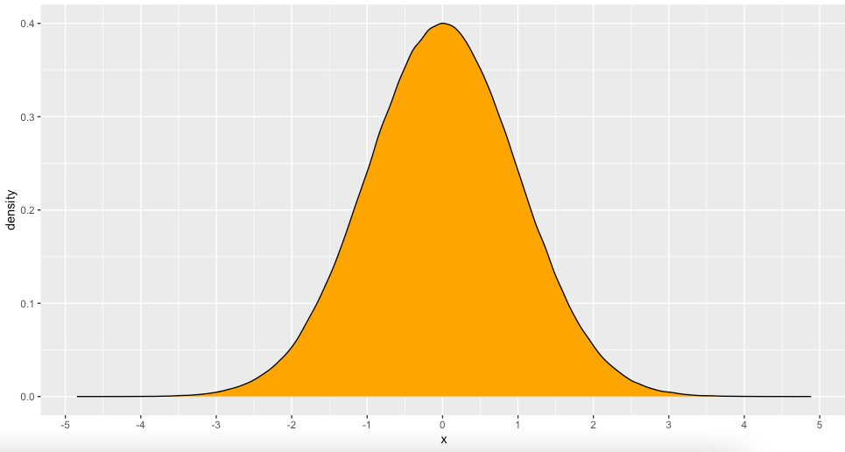
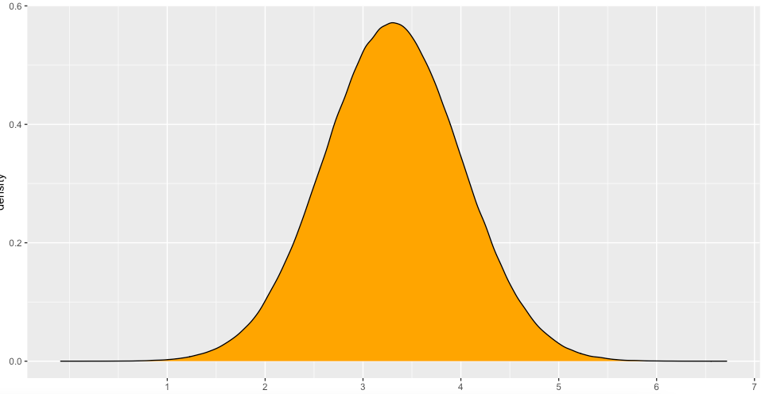
Norm Groups
Mean = 3.30, SD = 0.7

Slide 8
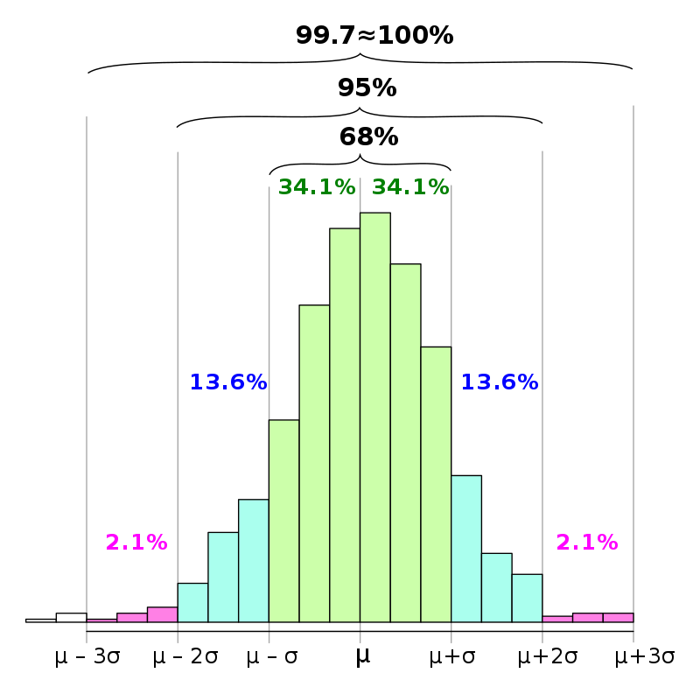
Norm Groups

Slide 9
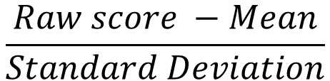
Norm Group: Standard Scores
S | Raw | Z score
1 | 1.36 | -1.52
2 | 2.27 | -0.86
3 | 3.77 | 0.23
4 | 4.97 | 1.10
5 | 4.15 | 0.50
6 | 2.51 | -0.68
7 | 6.12 | 1.93
8 | 2.89 | -0.41
9 | 3.39 | -0.04
10 | 3.10 | -0.26
$$\frac{Raw score −Mean}{Standard Deviation}$$
M = 3.45
SD = 1.38

Slide 10
Norm Group: Standard Scores
S | Raw | Z score
1 | 1.36 | -1.52
2 | 2.27 | -0.86
3 | 3.77 | 0.23
4 | 4.97 | 1.10
5 | 4.15 | 0.50
6 | 2.51 | -0.68
7 | 6.12 | 1.93
8 | 2.89 | -0.41
9 | 3.39 | -0.04
10 | 3.10 | -0.26

Slide 11
Norm Groups
Grand Mean = sum of means/number of means
(3.45 + 3.45 + 3.21 + 3.33 + 3.6) / 5 = (16.74)/5 = 3.348 ~ 3.35
Variance= sum of deviations / (number of deviations -1)

Slide 12
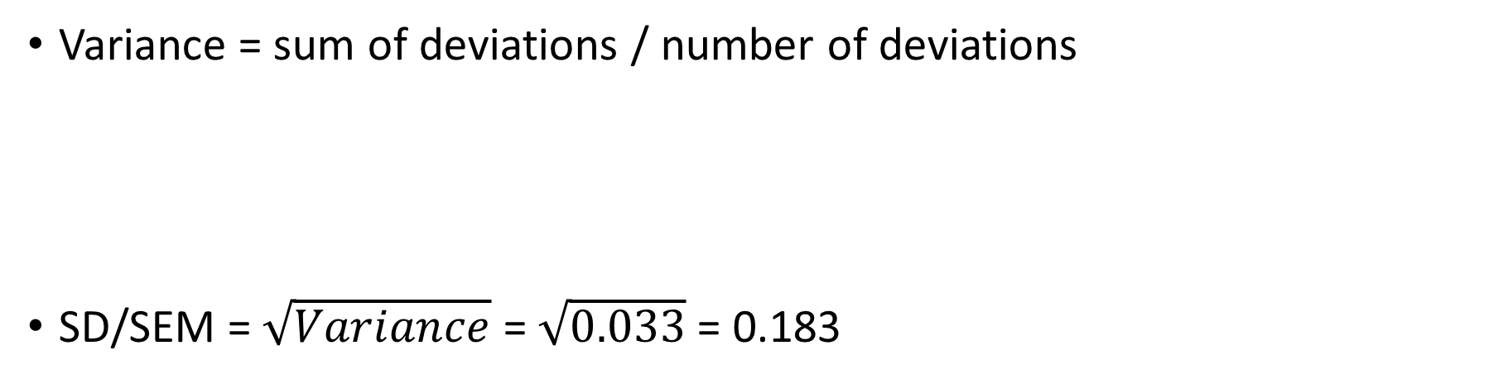
Norm Groups
Variance = sum of deviations / number of deviations
SD/SEM = $\sqrt{Variance}$ = $\sqrt{0.033}$ = 0.183
$$\frac{\text{ (3.35 – 3.45)}\text{2}\text{ + (3.35 – 3.21)}\text{ 2}\text{ + (3.35+3.33)}\text{ 2}\text{ + (3.35−3.15)}\text{ 2}\text{ + (3.35 −3.6)}\text{ 2} }{5−1}$$

Slide 13
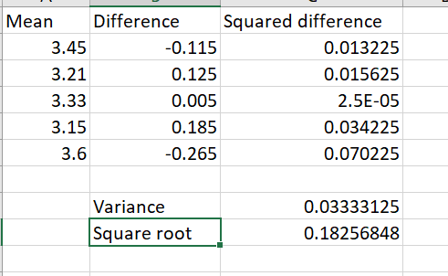
Norm Groups

Slide 14
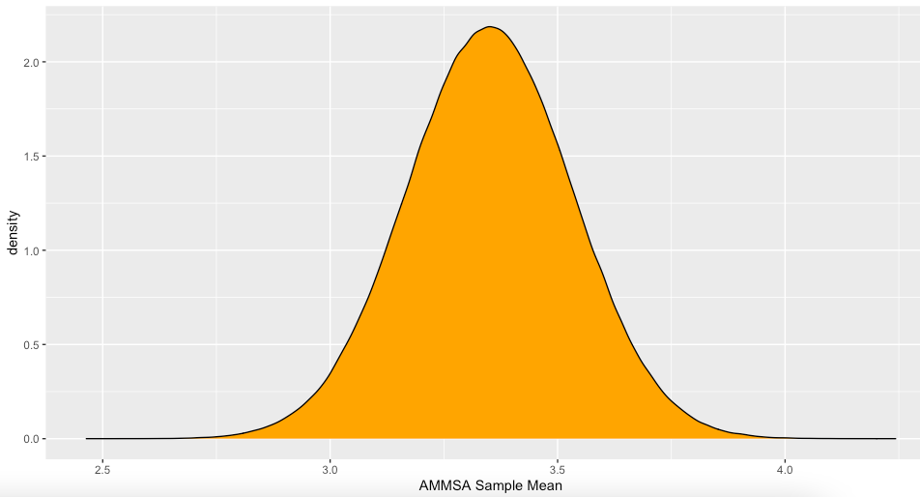
Norm Groups

Slide 15
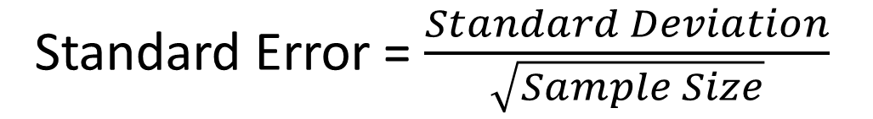
Norm Groups
Standard Error = $\frac{Standard Deviation}{\sqrt{Sample Size}}$

Slide 16
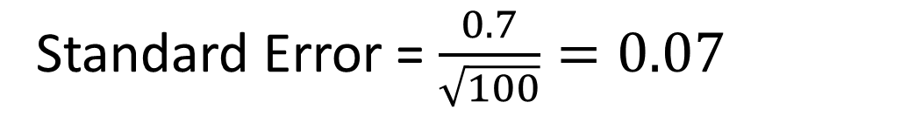
Norm Groups
We get an AMMSA sample mean of 3.12
We get an AMMA standard deviation of 0.7
We have a sample of 100
Mean estimate = 3.12, Confidence Interval [3.05, 3.19]
Standard Error = $\frac{0.7}{\sqrt{100}}=0.07$

Slide 17
Summary
We need norm groups to interpret individual scores
Norm groups are generally only based on one sample – although they may be large enough and representative enough to be useful
We can use norm group to estimate how far away from the mean a person’s score is – these are called standard scores

